Slide 1
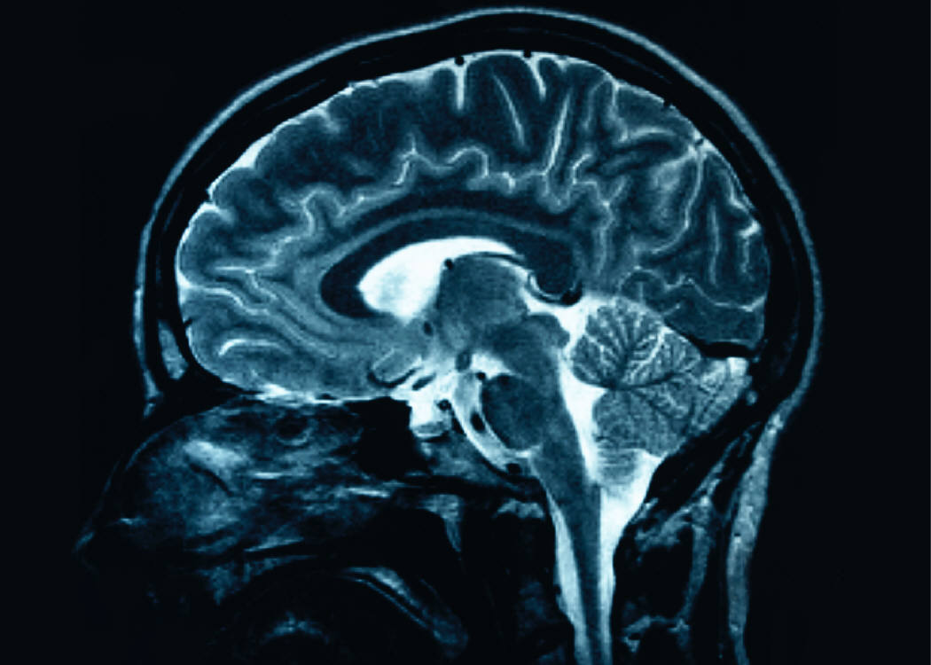
Synesthesia
Hannah Bosley
Ling 411

Slide 2
What is Synesthesia?
Synesthesia is a usually harmless neurological condition in which stimulation in one sensory modality triggers simultaneous and involuntary sensory experiences in another unrelated modality.
It is a fusion of different sensory perceptions: for example, hearing the word “Thursday” might cause a synesthete to simultaneously see the color orange; while another synesthete might experience the taste of strawberries when listening to the phoneme /i/.

Slide 3
More about Synesthesia
Many synesthetes do not realize that their perception of the world is unusual until they attempt to talk to someone about it.
When this happens, it can be frustrating, because it is understandably difficult for non-synesthetes to understand the synesthetic world.
Synesthesias frequently co-occur.
Having one type of synesthesia makes you 50% more likely to have a second type (Eagleman and Cytowic, 2009)
Synesthesia tends to be more common in children, and more common in women.
72% of self-reported synesthetes are female, says The Synesthesia List website.
Most synesthetes report having had synesthetic perception since childhood, although synesthesia can also be caused by brain damage or by psychoactive drugs such as LSD.
In some cases, synesthesia disappears later in life, usually after puberty.
Synesthesia tends to run in families.
The first known reports of synesthesia come from Francis Galton in 1880.

Slide 4
Types of Synesthesia
It is estimated that 1/23 people have some type of synesthesia (Simner, et. al. 2005)
Common types include
graphemes (letters or numbers)→color
days of week/months of year → color
time units → spatial location
sounds → color
smells → color
words →tastes
vision→ sounds
The synesthetically induced sensory attribute is referred to as a ‘concurrent’, while the sensory perception which induces the event is called an ‘inducer’.
This project focuses mainly on grapheme-color synesthesia and other synesthesias that relate to language. The goal is to understand more about how the brains of synesthetes process language in a different way than the brains of non synesthetes, and what in the brain causes synesthetic perception to occur so frequently with language and words as inducers.

Slide 5
Words in Color: More on Grapheme →Color Synesthesia
Each synesthete who experiences colored words and graphemes has their own idiosyncratic color palette.
A B C D E F G H I J K L M N O P Q R S T U V W X Y Z
Every grapheme has its own very specific color, and seeing that grapheme always invokes the experience of that certain color. Most synesthetes try to describe in vivid detail the unique colors of their alphabet.
Synesthetic experience is unidirectional, meaning that the letter A can cause the synesthete to experience red, but the color red does not cause the person to visualize A.
“…when a synesthete sees a 6 printed in black ink, she knows it is black and sees it as black, but she also has the experience of greenness. That experience of green is automatic and involuntary. For some, the experience is internal (green in the mind’s eye); for others, the color may have a location (say, superimposed on the letter). Typically, it is a little disconcerting for a synesthete to view a letter in the “wrong” color – for example, looking at a red 6 when it seems to that individual that only 3 can be red.”
-Neuroscientist David Eagleman, in his book Wednesday is Indigo Blue

Slide 6
Proving Synesthesia’s Legitimacy
Until very recently, people refused to acknowledge the existence of synesthesia, arguing that:
“the associations with color are just memories from childhood; we’ve all played with alphabet magnets that have different colors for the letters”
“the people with this ‘condition’ are making it all up, and just looking for attention”
“those who describe color-grapheme associations are really just being metaphorical (as is the case with the metaphors ‘seeing red’ or ‘green with jealousy’)”
Fortunately, the recent advances in neuroscience and brain imaging studies have allowed scientists and researchers to confirm the actual existence of synesthetic perception, and to objectively study it further.

Slide 7
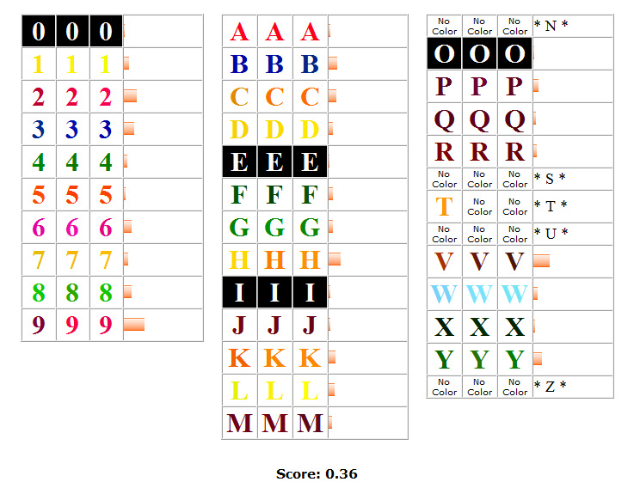
Tests to Verify Synesthesia
In 2002, fMRI scans demonstrated that when a word →color synesthete hears a spoken word, there is measurably higher activity in the region specialized for color vision (V4) when contrasted with non-synesthetic controls (Nunn, et. al., 2002).
The colors of a synesthete’s graphemes are consistent over time.
In a study measuring the consistency of color-assignment, both synesthetes and non-synesthetes were asked to assign colors to 117 names and words. After a week, the non-synesthetes only retained 38% of their original color assignments, while after a year, the synesthetes’ assigned colors were 92% identical (Baron-Cohen, et. al., 1993)
The Synesthesia Battery is an online test for synesthesia developed by Dr. David Eagleman, who runs a lab at B.C.M.
The battery involves several rounds where synesthetes are given a grapheme and asked to choose, from an adjustable color wheel, the closest possible representation of that grapheme’s color. Then, the graphemes are repeatedly flashed in random order and the synesthete must determine the grapheme’s color on a repetitive basis.

Slide 8
What is the Neural Basis of Graphemic Synesthesia?
There are two main hypotheses that explain how synesthesia works in the cortex.
The Cross Talk Hypothesis
States that this type of synesthesia results from an abnormally high number of connections between certain areas in the cortex; specifically, too much cross activation between the V4 color area in the occipital lobe and the number recognition area in the fusiform gyrus right next to it.
Suggests that the increased amount of connections are a result of an x-linked genetic mutation which causes defective neural pruning early in life.
The Disinhibition Hypothesis
This hypothesis states that, while excitation is balanced by inhibition in normal brains, in synesthetic brains the excitation can overcome the weakened inhibition. The synesthete brain actually has a normal number of connections, but faulty inhibition among the connections causes an increase in leakage between sensory modalities.
Suggests that the only difference between synesthetes and normal people is the functionality of inhibitory networks

Slide 9
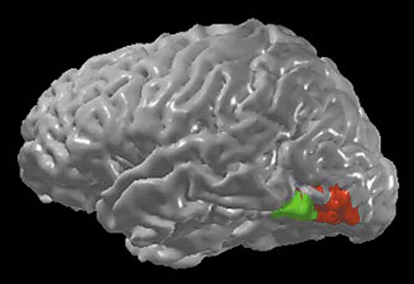
Cross Talk Hypothesis
The area in the brain responsible for recognizing letter/numeral graphemes(in green) is located in the left hemisphere just next to the color perception area called V4 (in red).
Both areas are located in the fusiform gyrus.
Ramachandran and Hubbard (2001) suggested that every time there is activation of neurons representing the recognition of numbers in the cortex, these neurons spur the activation of the neurons which represent color perception.

Slide 10
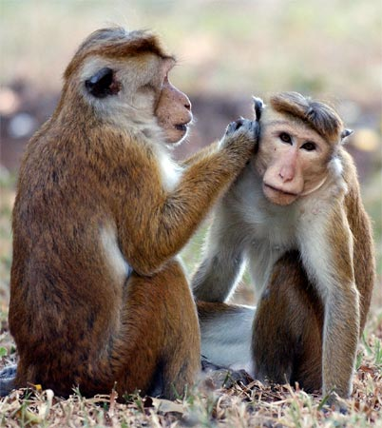
Cross Talk in Macaque Monkeys from Ramachandran and Hubbard, 2001
It has been observed that prenatally, there are far more connections from V4 to inferior temporal regions than there are in the mature adult macaque brain (Kennedy et al., 1997; Rodman &Moore, 1997).
In the fetal macaque monkey, about 70–90% of the connections to V4 come from higher areas, mainly the area called TEO (the macaque homologue of the human inferior temporal gyrus)
In the adult macaque, only approximately 20–30% of connections to V4 come from higher areas (Kennedy et al.,1997)

Slide 11
What this Means:
Assuming that the Macaque findings can be extrapolated to humans , this shows that a large amount of neural pruning occurs around the V4 area between childhood and adulthood.
Thus, if this neural pruning did not occur , the excessive connections between the V4 color area and other sensory areas in the cortex would persist into adulthood.
Ramachandran hypothesized that a certain x-linked genetic mutation would be the cause for this lack of pruning.
The excess of connections would likely cause synesthetic color perception upon the activation of other the other areas in the cortex to which V4 maintained abnormal excitatory connections.
This is interesting, as it is common for synesthetes to report that their synesthesia disappeared or weakened in intensity after puberty, which is when normal neural pruning occurs (Eagleman, 2009)
It has also been noted earlier that synesthesia is more common in children, and the finding with the macaque monkeys offers some explanation for that trend.

Slide 12
The Disinhibition Hypothesis (Grossenbacher and Lovelace, 2001)
Grossenbacher proposes that synesthesia occurs because of a failure of neighboring cortical areas to inhibit one another as necessary.
He cites the fact that synesthetic perception can be induced pharmacologically, through the use of drugs like LSD or other psychoactive substances. Almost everyone can experience pharmacologically induced synesthesia, thus the proposed hyperconnectivity that exists in a minority of people (according to the cross talk hypothesis), is not really necessary.
The disinhibition hypothesis, however, states that such experiences must take place through normally existing adult networks present in everyone, rather than on the formation of new connections between cortical areas.
Grossenbacher essentially describes that information is processed through several levels of the sensory hierarchy to some multi-modal sensory nexus before being fed back to lower areas, such as V4.
Notes:
(everyone can experience synesthesia from

Slide 13
Which One to Choose?
Both the Cross-Talk hypothesis, as well as the disinhibition hypothesis have merit.
However, the Cross-Talk hypothesis has been around since the dawn of synesthesia research more than 100 years ago (Eagleman).
It is more widely known, and thus there are far more studies done about hyperconnectivity than disinhibition.

Slide 14
Problems with Disinhibition
It is more difficult to test the disinhibition hypothesis, as its theory is mainly based on the occurrence of pharmacologically induced synesthesia.
As Ph.D. student Rebecca Lawson noted in her blog on synesthesia research, “it's not really kosher to give participants LSD in the hope that they start to see sounds”.
Also, the disinhibition hypothesis can only explain certain types of synesthesia, while the hyperconnectivity hypothesis can explain them all.
As we learned in class, inhibitory connections occur between neurons in neighboring cortical columns, while excitatory connections can occur between columns that are close together, OR far apart.
Disinhibition could be an explanation for some occurrences of grapheme-color synesthesia (the V4 color area and the number-recognition area are located very near to one another in the cortex, so there could be inhibitory connections between these two cortical areas)
But how do you explain other types of synesthesia, such as auditory word→taste synesthesia, where the inducing sensory function (recognizing a word: temporal lobe) and the concurrent sensory function (taste:anterior insula and frontal operculum of the frontal lobe) are located in two very separate regions of the brain? How can this be ‘disinhibition’, if there are no inhibitory connections to begin with?
The taste area of the brain has been determined to be in the anterior insula and frontal operculum of the frontal lobe (Pritchard, et. al. 1999) while the word recognition area, as we have learned in class, is in Wernicke’s area of the left temporal lobe.
For these reasons, we will take a closer look into the cross talk hypothesis, while keeping in might that the disinhibition hypothesis could still be useful in explaining certain types of synesthesia.

Slide 15
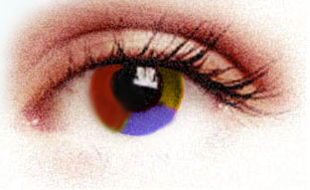
Grapheme → Color Synesthesia in the Cortex
Interestingly, another aspect of grapheme-color synesthesia may help to explain the neural basis of this phenomenon.
There is much variation among grapheme-color synesthetes as to where their concurrent colors appear spatially when they physically see a letter. Grossenbacher reports that:
Some synesthetes say that “color fills the printed letter”.
Others describe that “the color appears on an invisible screen located within arm’s reach in front of their eyes, not in the letter itself.
Some say that the concurrent colors appear in “the mind’s eye,” rather than anywhere outside the body.
abc
abc
abc

Slide 16
This tells us that…
These differences in spatial color location of concurrents demonstrate that there is likely a great deal of variation in the cortical representation of the concurrent color among synesthetes.
Grossenbacher suggests that the differing spatial location of colors with their inducing letters may be the result of differing spatiotopic networks being recruited among synesthetes. (Grossenbacher and Lovelace, 2001)
This leads to the topic of differentiation among ‘higher’ and ‘lower’ synesthetes to be discussed momentarily.
Also, we can speculate that these differences in perception are due to differences in top-down and bottom-up processing.

Slide 17
Synesthesia as both a Perceptual and Conceptual experience
Synesthesia can occur as either a perceptual or conceptual experience.
Ramachandran, et. al (2001) report that a majority of synesthetes describe that their concurrent colors are evoked more intensely when they imagine the concept of a number than when they physically see actual numbers
However, there are still many other synesthetes who experience their concurrent colors vividly when they see a written numeral.
This begs the question as to whether synesthesia is a top-down process, a bottom-up process, or some combination thereof.
Can be tested using the ‘Perky Effect’.
Researchers report that synesthetes engaging in mentally visualizing a number concept have partial activation of both category-specific regions involved in visual recognition (O’Craven & Kanwisher, 2000) and early visual pathways (Farah, 2000; Farah et al., 1992; Klein et al., 2000; Kosslyn et al., 1999; 1995).
This helps to explain the varying degrees of synesthesia among subjects:
The extent to which a synesthete’s perception is the result of partial top-down activation
How much this activation is ‘vetoed’ by actual bottom-up processing
The exact location of the cross-wiring or hyperconnectivity within the cortex (whether the subject is a higher or lower synesthete)

Slide 18
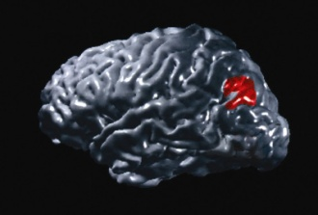
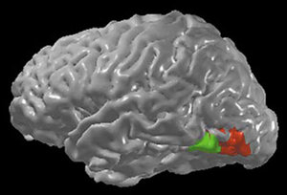
“Higher” and “Lower” Synesthetes
Ramachandran and colleagues (2001) suggested the possibility that there are two different types of grapheme-color synesthetes.
They propose that the same genetic mutation which causes the defective pruning and hyperconnectivity in the brains of synesthetes can be expressed to varying degrees and selectively in the fusiform or angular gyri.
If expressed in the fusiform gyrus only, the person will be a Lower synesthete.
If expressed in the angular gyrus only, the person will be a Higher synesthete.
If the gene is expressed very diffusely, there may also be mixed types who express many different varieties of synesthesia.
For instance, if the ‘hyperconnectivity gene’ is expressed between the primary gustatory cortex and the somatosensory cortex, the person might be a synesthete who “tastes shapes” (Ramachandran, et. al. 2001)
Higher Synesthete→
Lower
←Synesthete

Slide 19
Fusiform Gyrus and “Lower” Synesthetes
Lower synesthesia is the rarer type. These synesthetes are the ones who are sensitive only to the written form of the grapheme.
They do not experience concurrent colors with the concept of the number, they MUST see the written form of a grapheme in order for the concurrent colors to be evoked.
This is due to their lower level of association, explains David Eagleman (2009)

Slide 20
Importance of Contrast in Lower Synesthetes
This was tested by Hubbard et. al. (2006).
He presented written graphemes to lower synesthetes at varying levels of contrast.
He found that black letters on a white background triggered synesthetic color, as did a white letter on a black background.
However, a gray letter on a light gray background did not induce synesthetic color (or at least not with the same strength).
F
F
F

Slide 21
Contrast in Higher Synesthetes
On the other hand, higher synesthetes are not affected by the appearance of contrast in their graphemes.
This is because the mere concept of a number is able to evoke concurrent colors in higher synesthetes.
All higher synesthetes have to do in order to trigger synesthetic concurrents is to think about a number. Eagleman (2009) explains this by stating that higher synesthetes have more hyperconnectivity in the cortex.
Many higher synesthetes experience color concurrents even when they see a roman numeral, whereas most lower synesthetes do not.

Slide 22
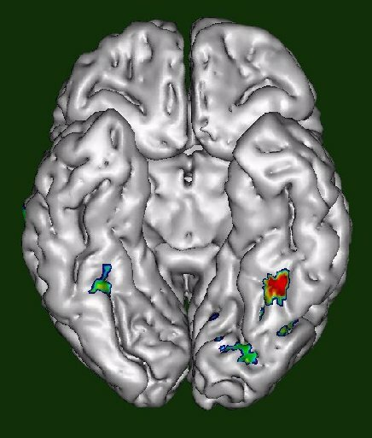
Different Patterns of “Cross Talk” in Higher and Lower Synesthetes
In the fusiform gyrus, which is the only hypothesized hyperconnective region in lower synesthetes, there is an area called the visual word form area (VWFA).
Hubbard and colleagues hypothesize that in lower synesthetes, VWFA is cross talking directly to the V4 color area. This is why it is necessary for lower synesthetes to visually perceive the grapheme to trigger synesthetic perception.
In higher synesthetes, they suggest that V4 is cross talking to another region, probably the anterior inferior temporal cortex.
The AIT cortex is responsible for conceptual representations of words, letters, and numbers rather than the details of their visual forms.
This hypothesis makes sense, because for higher synesthetes, color perception is controlled by context and meaning rather than by actual letter/number form.

Slide 23
Angular Gyrus Involvement in Higher Synesthetes and Metaphors
Regions concerned with more abstract numerical concepts and more sophisticated color processing are located near the angular gyrus (Ramachandran and Hubbard, 2001).
For this reason, hyperconnectivity in the angular gyrus (as is the case with higher synesthetes) might lead to evocation of concurrent colors with the mere concept of a number.
The angular gyrus is very important in cross-modal sensory interactions within the cortex (given its location at the convergence of the parietal, occipital, and temporal lobes).
The angular gyrus is also very important for understanding metaphors, especially cross-sensory metaphors (“hot pink”)
It has been shown that patients with lesions on the angular gyrus have difficulty understanding metaphors and are often very literal-minded (Gardner, et. al. 1975)

Slide 24
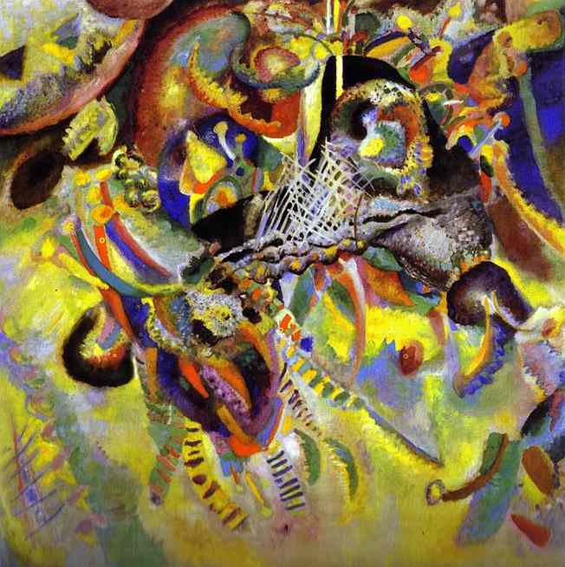
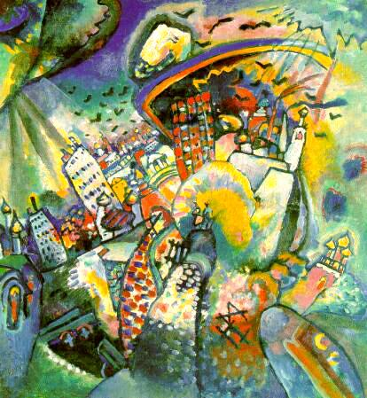
Metaphors and Synesthesia
There is a very high occurrence of synesthesia among poets, artists, and authors.
Vladimir Nabokov , Wassily Kandinsky and many others were synesthetic
Hyperconnectivity in the cortex might explain the talent that many synesthetes have for understanding and creating metaphors.
There are many ‘synesthetic metaphors’ that are common in society:
Describing a gaudy or bright item of clothing as “loud” or “busy”
“Green with Jealousy”
Ramachandran (2001) describes that in synesthetes there may be a larger number of cross connections in specific regions of the right hemisphere.
In class and in the assigned reading about right hemisphere language comprehension, we have already looked into the role of the right hemisphere in processing non-literal aspects of language.

Slide 25
Right Hemisphere in Grapheme →Color Synesthesia
Frith and Paulescu, et. al. (1997) conducted an imaging study on the brains of six female grapheme-color synesthetes.
They measured the rCBF as the synesthetes listened to sets of words (which evoked a color response) and compared the levels of activation with the rCBF in the same six synesthetes as they just listened to plain tones (which do not evoke color in this type of synesthesia)
What they found to be surprising was that two non-visual regions in the right hemisphere, the middle frontal gyrus and the insula, were activated during the appearance of color-concurrents.
Normally, these areas are associated with functions of complex motor control and decision making.
Interestingly, the insula on the left side showed a pronounced deactivation complementary to activation on the right side.
Ione and Tyler, et. al. (2004) offer and explanation of these results.
“...they represent a control mechanism by which the synesthete brain switches from a predominant left-hemisphere activation of speech (since five of the six synesthetes tested were right-handed, and therefore would have had left hemisphere dominance) to a right-hemisphere activation of verbal associations not normally accessible in non-synesthetes.”

Slide 26
Synesthesia and Brain Damage from Ione and Tyler, et. al. (2004)
One man’s synesthesia disappeared after the removal of a large cystic mass extending from his temporal lobe to midbrain
Another synesthetic artist, Jonathan I., became colorblind after a car accident. He completely lost his color-concurrents with graphemes and numbers. He also stopped dreaming in color.
Patients with temporal-lobe epilepsy have a tendency to experience synesthetic perception.

Slide 27
Conclusions:
The two main existing hypotheses, the cross-talk (or hyperconnectivity) hypothesis and the dishibition hypothesis both make valid arguments as to explain the mechanics of synesthesia in the cortex
The cross-talk hypothesis is more widely applicable and testable
It is likely that (non pharmacologically-induced) grapheme→color synesthesia is the result of hyperconnectivity in the cortex, possibly as a result of a genetic mutation that disrupts neural pruning.
The V4 color region in the fusiform gyrus is definitely involved in the experience of color-grapheme synesthesia.
Many studies demonstrate that the neural cortices of grapheme-color synesthetes have abnormal excitatory connections between V4 and other sensory areas.
The variance among subjects in degree and extent of these connections likely explains the differences in perception of color-concurrents across grapheme-color synesthetes.

Slide 28
References
Ione, A &Tyler, C (2004). Synesthesia: Is F Sharp Colored Violet? Journal of the History of the Neurosciences Vol. 13, No. 1, pp. 58–65
Grossenbacher, P. & Lovelace, C (2001). Mechanisms of Synesthesia: Cognitive and Physiological Constraints. Trends in Cognitive Neurosciences Vol. 5, No. 1, pp. 36-41
Ramachandran, V. & Hubbard, E. (2001). Psychophysical Investigations into the Neural Basis of Synaesthesia. Proceedings of the Royal Society of London B 268:979-983
Ramachandran, V. & Hubbard, E. (2001). Synaesthesia-A window into perception, thought, and language. Journal of Consciousness Studies 8(12): 3-34.
Eagleman, D. & Goodale, M (in press). Why Color Synesthesia Involves More Than Color.
Trends in Cognitive Neurosciences.
Paulescu, E. et al. (1995) . The physiology of coloured hearing: a PET activation study of colour-word synaesthesia. Brain 118, 661–676
Eagleman, D and Cytowic, R. Wednesday is Indigo Blue. 2009 MIT Press, Cambridge, MA. Print.
Lawson, R. “Post-Hypnotic Synaesthesia”. Rebecca P. Lawson Ph.D. Student. https://rebeccaplawson.webs.com. April 2010.

