Slide 1
Applications of Nanotechnology to Medicine
December 2014

Slide 2
Areas of impact
Drug delivery and new therapies
Diagnostic analyses
Biological research
Notes:
2

Slide 3
Drug Delivery

Slide 4

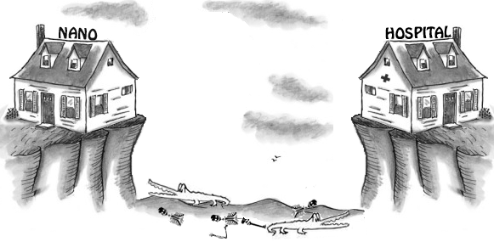
Nanoscience, translation, clinic
http://lapotko.rice.edu

Slide 5
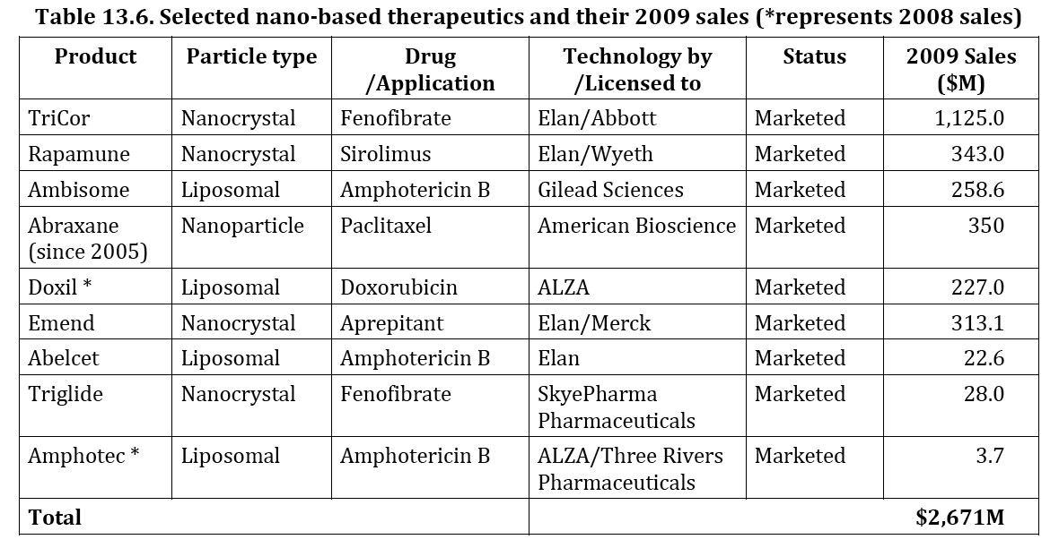
Commercial Nanotherapeutics
Source: Nanotechnology research directions for societal needs in 2020
Notes:
5

Slide 6
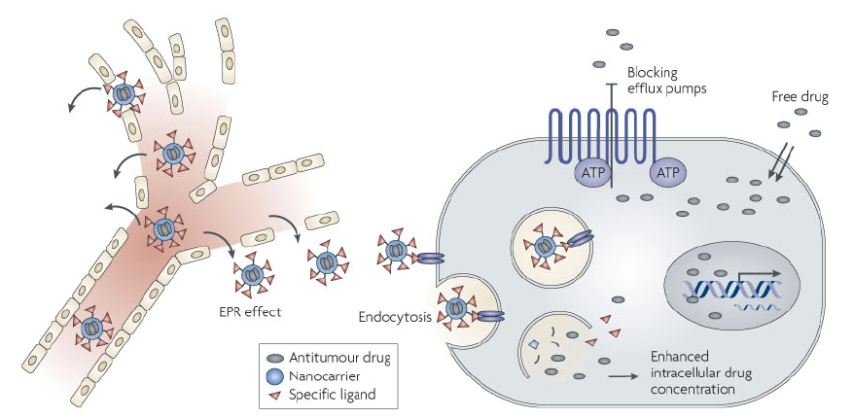
Action of anticancer nanoparticle
Nanoparticle therapeutics: an emerging treatment modality for cancer, M. E. Davis, Z. Chen and D. M. Shin, Nature Reviews: Drug discovery 7, 771 (2008).
Notes:
6

Slide 7
Nanoparticle drug delivery
(possible uses)
Cancer therapy,antifungal,antiemetic, cholesterol control (previous slide)
MRI contrast agents
Radioactivity imaging agents
Osteoporosis drugs
Antibacterial or antiviral delivery
Notes:
7

Slide 8
Drug delivery advantages
Can excite minimal immune responses.
Notes:
8

Slide 9
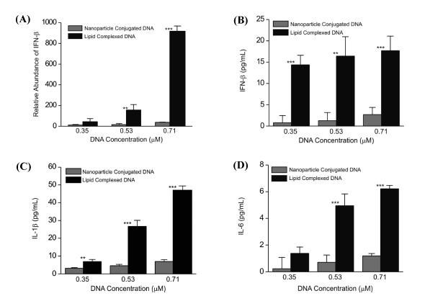
Immune response to Au-DNA
m-RNA for IFN-β
Cell type:
RAW 264.7
M. D. Massich, D. A. Giljohann, D. S. Seferos, L. E. Ludlow, C. M. Horvath, and C. A. Mirkin, Regulating Immune Response Using Polyvalent Nucleic Acid-Gold Nanoparticle Conjugates, Molecular Pharmaceutics 6 1934 (2009).
Notes:
9

Slide 10
Drug delivery advantages
Can excite minimal immune responses.
Can carry a large payload.
Notes:
10
.

Slide 11
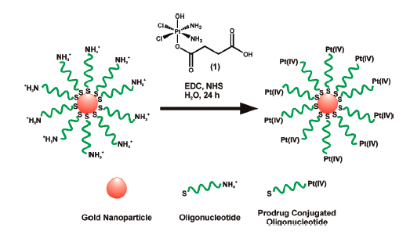
Au delivery of Pt anticancer drug
S. Dhar, W. L. Daniel, D. A. Giljohann, C. A. Mirkin, and S. J. Lippard, Polyvalent Oligonucleotide Gold Nanoparticle Conjugates as Delivery Vehicles for Platinum(IV) Warheads, J. Am. Chem. Soc. 131, 14652 (2009).
Notes:
11

Slide 12
The Pt oxidation state matters
Pt(IV) complexes are reduced in the intracellular milieu to yield the cytotoxic Pt(II) species through reductive elimination of axial ligands.

Slide 13

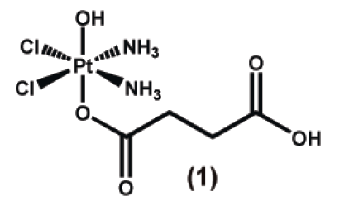
Cell culture cytotoxicity tests
U2OS=Human osteosarcoma
A549=Human lung carcinoma
HeLa= Cervical cancer
PC3 = Human prostate cancer
S. Dhar, W. L. Daniel, D. A. Giljohann, C. A. Mirkin, and S. J. Lippard, Polyvalent Oligonucleotide Gold Nanoparticle Conjugates as Delivery Vehicles for Platinum(IV) Warheads, J. Am. Chem. Soc. 131, 14652 (2009).

Slide 14
Drug delivery advantages
Can excite minimal immune responses.
Can carry a large payload.
Can carry multiple binding ligands.
Notes:
14

Slide 15
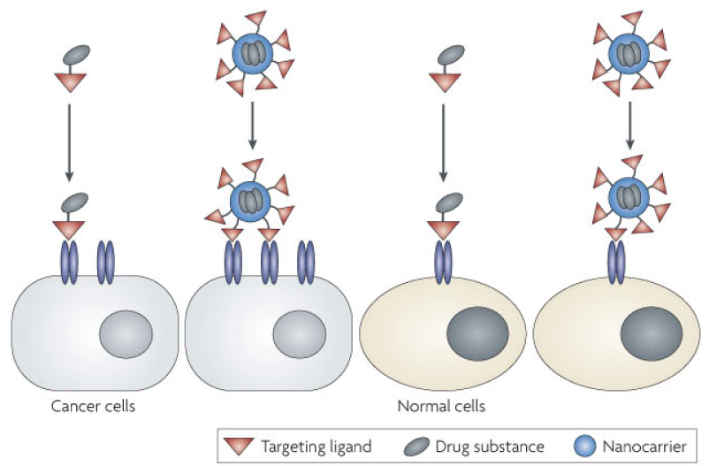
Nanoparticles hold multiple ligands
Nanoparticle therapeutics: an emerging treatment modality for cancer, M. E. Davis, Z. Chen and D. M. Shin, Nature Reviews: Drug discovery 7, 771 (2008).
Notes:
15

Slide 16
Drug delivery advantages
Can excite minimal immune responses.
Can carry a large payload.
Can carry multiple binding ligands.
Can carry multiple different drugs.
Notes:
16

Slide 17
Overcoming evolution
Both bacteria and cancer cells evolve defenses against therapeutic agents. These defenses can be attacked by same nanoparticle that carrys the cell killer.

Slide 18
Drug delivery advantages
Can excite minimal immune responses.
Can carry a large payload.
Can carry multiple binding ligands.
Can carry multiple different drugs.
Can maintain drug concentrations longer.
Notes:
18

Slide 19

Decay profiles
CPT conc. (μg/ml)
time (hours)
T. Schluep, J, Cheng, K. T. Khin, M. E. Davis, Cancer Chemother Pharmacol (2006) 57: 654. (redrawn)
Notes:
19

Slide 20
Drug delivery advantages
Can excite minimal immune responses.
Can carry a large payload.
Can carry multiple binding ligands.
Can carry multiple different drugs.
Can maintain drug concentrations longer.
Typically they enter by endocytosis, which can bypass some resistance mechanisms.
Notes:
20

Slide 21
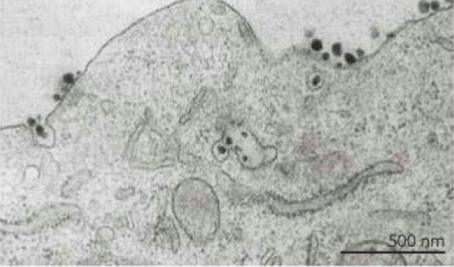
TEM of nanoparticles entering cell through endocytosis
Nanoparticle therapeutics: an emerging treatment modality for cancer, M. E. Davis, Z. Chen and D. M. Shin, Nature Reviews: Drug discovery 7, 771 (2008).
Notes:
21

Slide 22
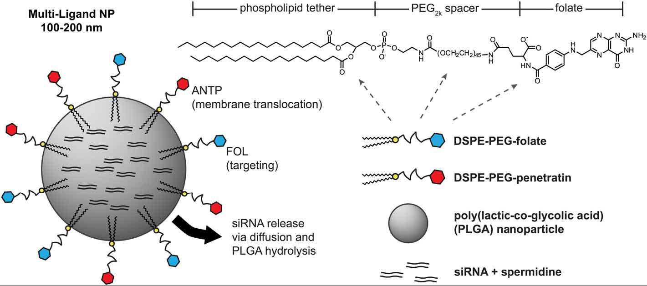
siRNA nanoparticle delivery
Chene, Christopher J.; Saltzman, W. Mark
BIOMATERIALS Volume: 32 Issue: 26 Pages: 6194-6203

Slide 23
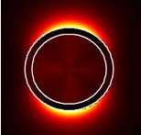
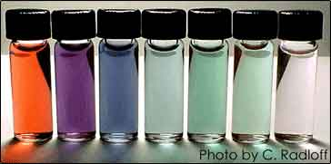
Au nanoshells tune absorption λ
N. Halas, Rice University website
Notes:
23
23

Slide 24
Cancer phototherapy
Use a near-IR laser to heat gold nanoshells and destroy the cancer cell (N. J. Halas, J. L. West).
Use a pulsed near-IR laser to explode a cluster of gold nanoshells and destroy the cancer cell (D. O. Lapotko).

Slide 25
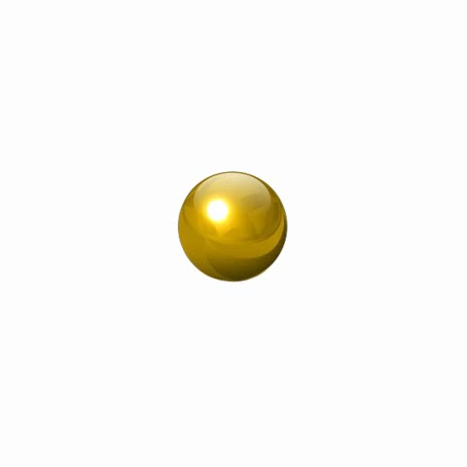
Laser pulse + gold = Plasmonic Nanobubble
Short laser pulse
10 ps
Plasmonic conversion to heat
1 ps
Transient vapor nanobubble
1-1000 ns
Evaporation of adjacent liquid
100 ps
On-demand non-stationary transient event, not a particle
http://lapotko.rice.edu

Slide 26
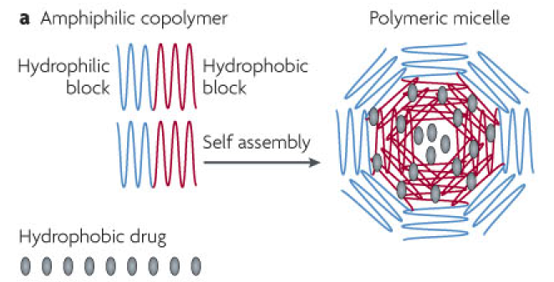
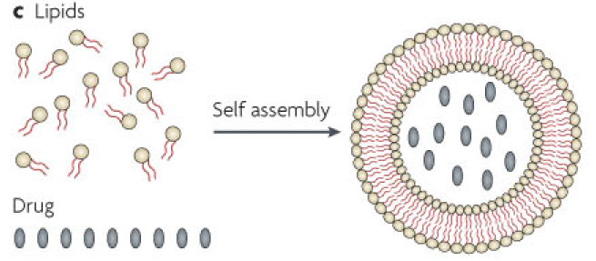
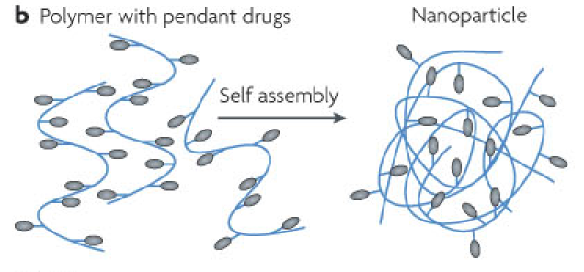
Other drug carriers
Nanoparticle therapeutics: an emerging treatment modality for cancer, M. E. Davis, Z. Chen and D. M. Shin, Nature Reviews: Drug discovery 7, 771 (2008).

Slide 27
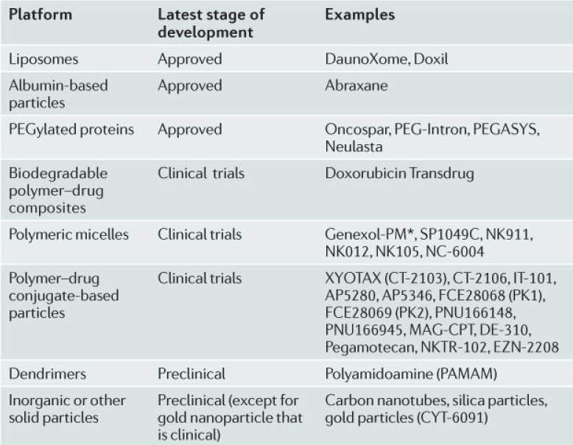
Nanoscale systems for systemic cancer therapy

Slide 28
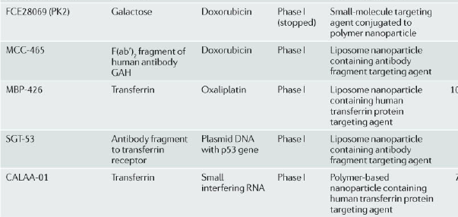
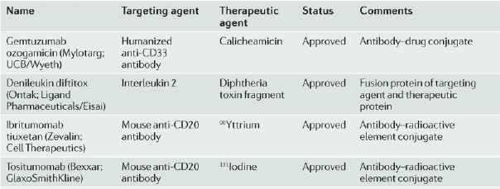
Targeted anticancer drugs
Nanoparticle therapeutics: an emerging treatment modality for cancer, M. E. Davis, Z. Chen and D. M. Shin, Nature Reviews: Drug discovery 7, 771 (2008).

Slide 29
Nanotherapy is not just for cancer
One example

Slide 30
Mitigating Oxygen Radical Damage
When blood flow has been temporarily stopped by a clot as in stroke, affected cells retreat into a new state.
When blood flow is restored, the flood of O₂ creates harmful cell killing radicals.
A group headed by James Tour has developed an oxygen radical destroying drug therapy.

Slide 31
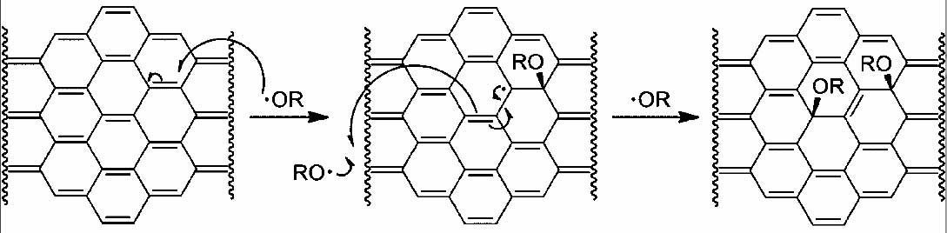
NanoCarbon Antioxidant
Nanocarbon clusters functionalized with polyethyleneglycol (HCC-PEG) about 50nm in diameter.
Purpose restoring cerebral blood flow after TBI accompanied by major blood loss through the antioxidant chemistry below.
Developed by James Tour

Slide 32
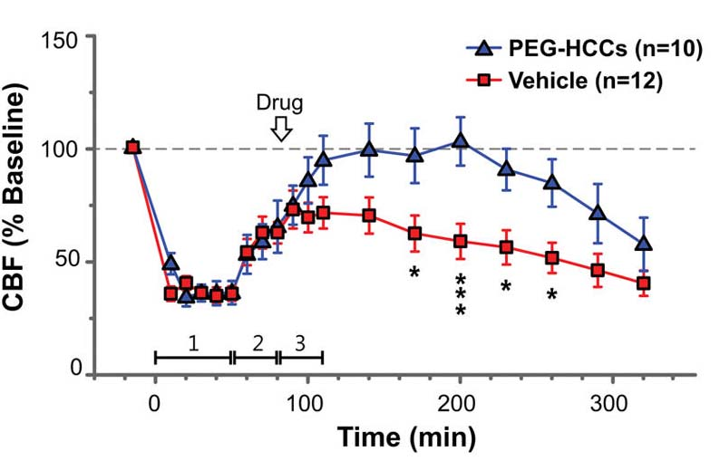
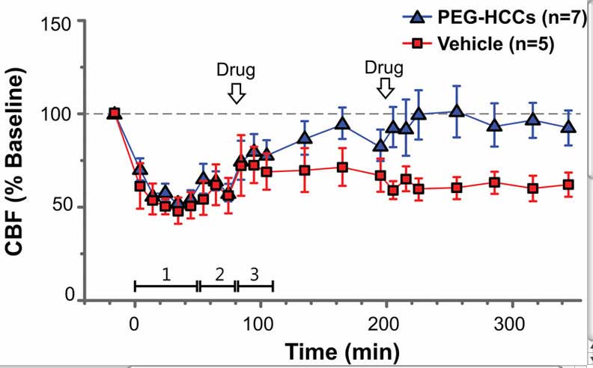
Cerebral Blood Flow after Traumatic Brain Injury with major blood loss
BITNER ET AL. ACS Nano 6 8007 (2012)

Slide 33
Diagnostic Analyses

Slide 34
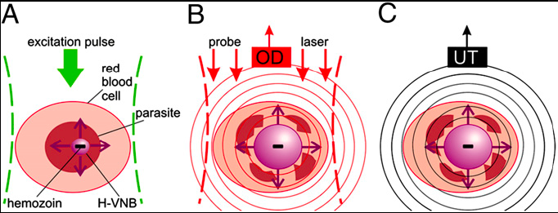
Non-invasive rapid malaria diagnosis
E. Y. Lukianova-Hleb,….,Dmitri Lapotka, Proceedings of the National Academy of Sciences, 111 900-905 (2014)

Slide 35
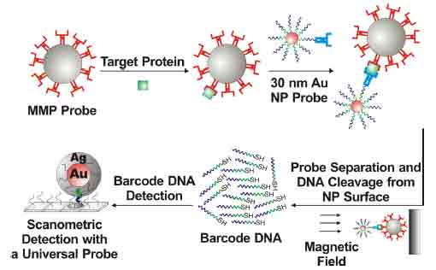
Barcode Analysis
C. S. Thaxton, R. Elghanian, A. D. Thomas, S. I. Stoeva, J. S. Lee, N. D. Smith, A. J. Schaeffer, H. Klocker, W. Horninger, G. Bartsch, and C. A. Mirkin, Nanoparticle-based bio-barcode assay redefines "undetectable'' PSA and biochemical recurrence after radical prostatectomy, PNAS 106, 18437 (2009).

Slide 36
PSA Calibration
sensitivity limit conventional assay 0.1 ng/ml
0.00033 ng/ml
C. S. Thaxton, R. Elghanian, A. D. Thomas, S. I. Stoeva, J. S. Lee, N. D. Smith, A. J. Schaeffer, H. Klocker, W. Horninger, G. Bartsch, and C. A. Mirkin, Nanoparticle-based bio-barcode assay redefines "undetectable'' PSA and biochemical recurrence after radical prostatectomy, PNAS 106, 18437 (2009).

Slide 37
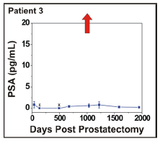
No Evidence of Recurrence
PSA 5.8
Gl 5
T_{2b}
Std MDC 100
C. S. Thaxton, R. Elghanian, A. D. Thomas, S. I. Stoeva, J. S. Lee, N. D. Smith, A. J. Schaeffer, H. Klocker, W. Horninger, G. Bartsch, and C. A. Mirkin, Nanoparticle-based bio-barcode assay redefines "undetectable'' PSA and biochemical recurrence after radical prostatectomy, PNAS 106, 18437 (2009).

Slide 38
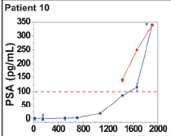
Recurrence Evident
PSA 5.0
Gl 6
T_{2a}
Commercial
assay
Days post-prostatectomy
C. S. Thaxton, R. Elghanian, A. D. Thomas, S. I. Stoeva, J. S. Lee, N. D. Smith, A. J. Schaeffer, H. Klocker, W. Horninger, G. Bartsch, and C. A. Mirkin, Nanoparticle-based bio-barcode assay redefines "undetectable'' PSA and biochemical recurrence after radical prostatectomy, PNAS 106, 18437 (2009).

Slide 39
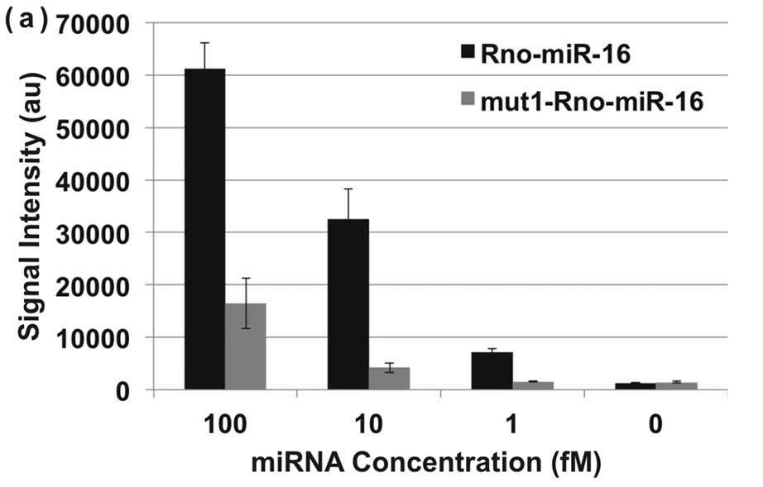
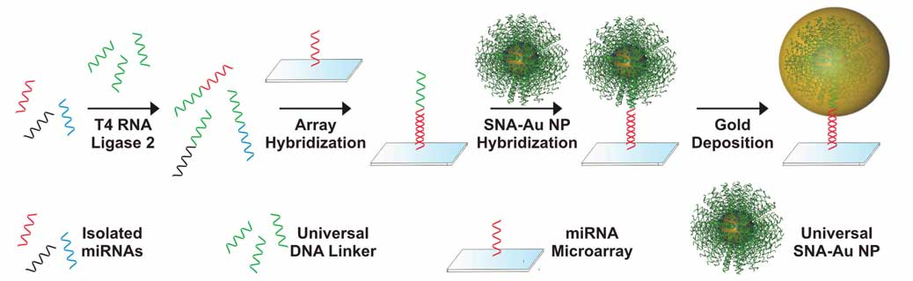
Increased selectivity micro-RNA detection
Micro-RNA is isolated by a standard scheme and tied to array unselectively. Gold nanoparticles covered with selective conjugates are added and bind. Then excess gold is deposited on them. The gold particles are detected by light scattering.
Scanometric MicroRNA Array Profiling of Prostate Cancer Markers Using Spherical Nucleic Acid−Gold Nanoparticle Conjugates, Ali H. Alhasan et al, Anal. Chem. 84, 4153 (2012)

Slide 40
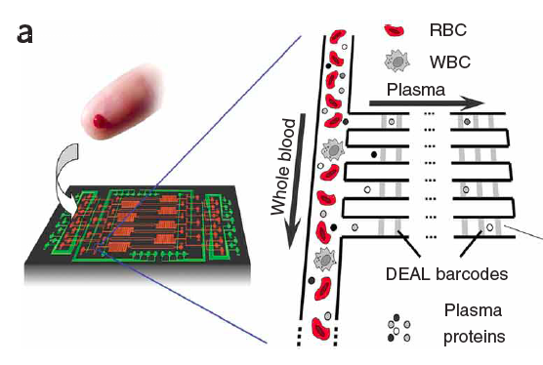
Microfluidics protein analysis
R. Fan, O. Vermesh, A. Srivastava, B. K. H. Yen, L. D. Qin, H. Ahmad, G. A. Kwong, C. C. Liu, J. Gould, L. Hood, and J. R. Heath, Integrated barcode chips for rapid, multiplexed analysis of proteins in microliter quantities of blood, Nature Biotechnology 26 (12), 1373 (2008).

Slide 41
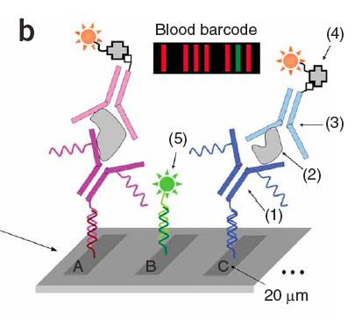
Fluorescent bar codes
DNA AB conjugate
Plasma protein
Biotin-labeled AB
Strepavidin-Cy5
DNA-Cy3 reference
R. Fan, O. Vermesh, A. Srivastava, B. K. H. Yen, L. D. Qin, H. Ahmad, G. A. Kwong, C. C. Liu, J. Gould, L. Hood, and J. R. Heath, Integrated barcode chips for rapid, multiplexed analysis of proteins in microliter quantities of blood, Nature Biotechnology 26 (12), 1373 (2008).

Slide 42
Biological research
Example: nanoflares
A. E. Prigodich, …., C. A. Mirkin, Multiplexed Nanoflares: mRNA Detection in Live Cells, Analytical Chemistry 84 (4), 2062 (2012).

Slide 43
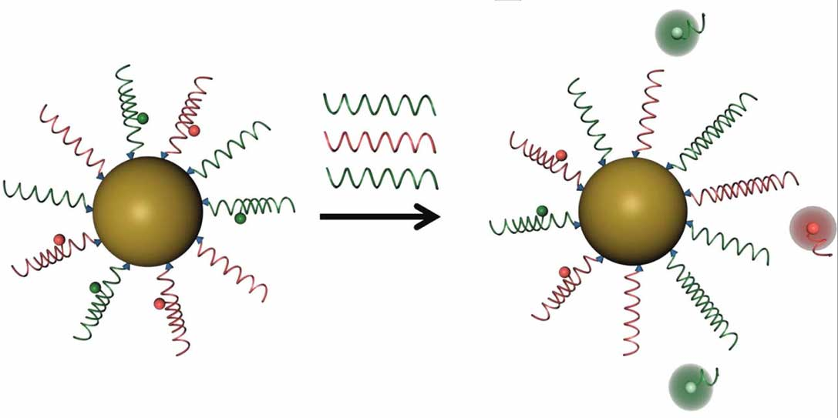
Nanoflare scheme
Notes:
a

